Slide 1
Amazon Sales Analysis Report
YTD & QTD Performance Overview

Slide 2
Executive Summary
Objective:
To analyze Amazon product sales trends and identify key drivers impacting revenue and customer engagement.
Key Insights:
Total YTD Sales reached $2.18M, with QTD Sales of $811K.
Over 27.7K products sold and 19.4M reviews, showing strong customer engagement.
Men Shoes category contributes the highest share (43% of total sales).
Electronics categories like Cameras and Mobile Accessories also perform strongly.
Sales peak observed in August–September and during festive weeks.
Car Accessories and Toys have the lowest contribution and need improvement.

Slide 3
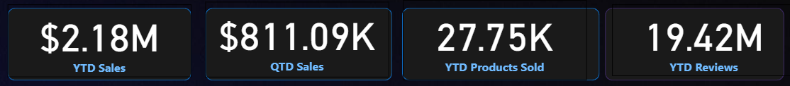
Overall Sales Snapshot – Key Performance Indicators
Insights:
Strong yearly sales performance with significant quarterly contribution.
Customer engagement is very high with 19M+ reviews.
Fashion (Men Shoes, Clothes) and Electronics (Cameras, Mobile Accessories) are the key growth drivers.
Seasonal spikes (Aug–Sep, festive weeks) indicate campaign effectiveness.
Car Accessories & Toys underperform and need improvement strategies.

Slide 4
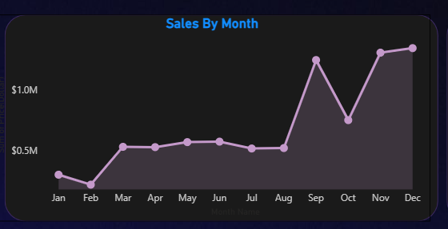
Sales by Month :
Sales trend is mostly steady.
Peak in Aug–Sep.
Q4 (Oct–Dec) strong performance.

Slide 5
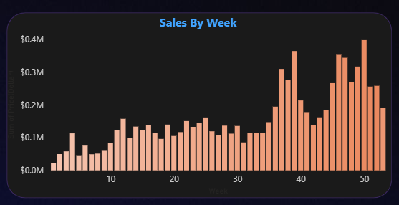
Sales by Week :
Weekly sales rising steadily.
Spikes during festive/promotional weeks.

Slide 6
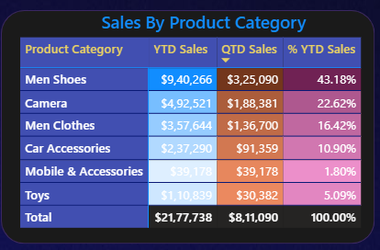
Sales by Product Category :
Top: Men Shoes – $940K (43%)
Cameras & Men Clothes → strong sales.
Car Accessories & Toys → low contribution.

Slide 7
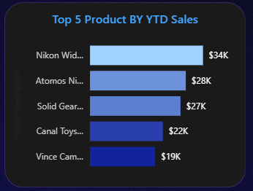
Top 5 Products :
By Sales: Nikon, Atomos, Solid Gear.
By Reviews: SanDisk products lead.

Slide 8
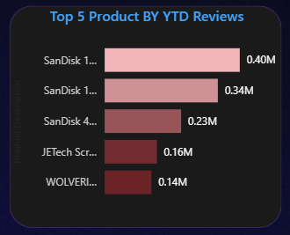
Top 5 Products by YTD Reviews :
SanDisk dominates the review share with 3 products in the Top 5.
High reviews indicate customer trust and brand presence.
Electronics (storage & accessories) show stronger customer engagement than other categories.

Slide 9
Conclusion :
Healthy sales performance.
Expansion possible in weaker categories.
Data-driven strategies can boost future sales.

Slide 10
Thank You

